Slide 1
LAB - 06
While and do-while loop

Slide 2
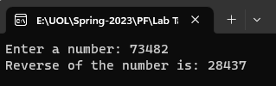
Task - 1
Write a C++ program to reverse a number using while loop.

Slide 3
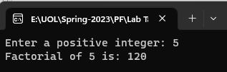
Task - 2
Write a program that calculates the factorial of a number using while loop.

Slide 4
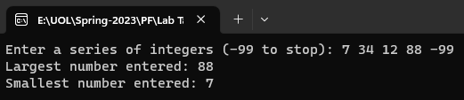
Task - 3
Write a program with a while loop that lets the user enter a series of integers. The user should enter -99 to signal the end of the series. After all the numbers have been entered, the program should display the largest and smallest numbers entered.

Slide 5
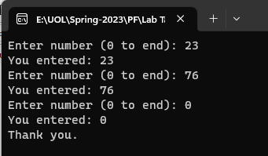
Task - 4
Write a program using do-while loop that prints any number you enter until you enter 0.

Slide 6
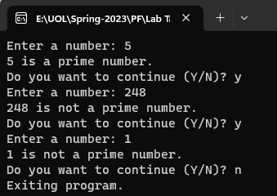
Task - 5
Write a program using do-while loop that asks the user to enter a number and decide whether it is a prime number or not. Also prompt that whether the user wants to keep continue or not (Y/N). If the user enters Y the program should provide another chance to test a number, otherwise exits.

Slide 7

Task - 6
Write a C++ program that will convert a binary number to decimal by using do-while loop.

Slide 8
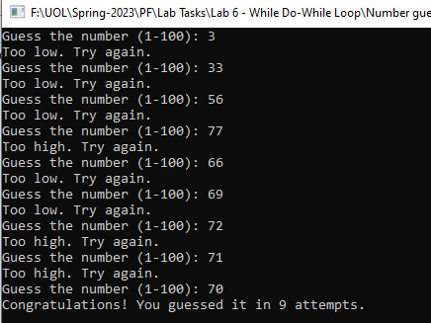
Task - 7
Create a C++ program that asks the user to guess a random number between 1 and 100 using a do-while loop. Provide hints like "too high" or "too low" until the user guesses correctly.

Slide 9

Task - 8
Write a C++ program to print the Fibonacci series up to a given number using a do-while loop.

